Slide 1


Sprint DELIVERY
Sprint 0
RB-03 Group 2

Slide 2

Contents
Sprint Goals
Progress
Features
Inquiries
Plans

Slide 3

Sprint Goals
Understand the project goal
Visualize the current system
Come up with a solution
Set-up project
Start with documentation
Notes:
We set out at the start of week 1 to understand what the idea of the project is and visualize the current system.
Then we wanted to come up with a project idea for a solution that could help improve the system.
After the idea would have been approved by the client, we planned on getting our project set-up and beginning with the documentation.

Slide 4

Progress
Project Division
Project Idea
SCRUM Board Set-up
Project Plan
User Stories
Notes:
During week 1, we focused on understanding the project and coming up with an idea about a solution. However, once we got together with the other groups of the class, there was another group that also wanted to work on a similar solution, so all the team leaders got together and divided the tasks between each group.
After having discussed what needs to be done with the class we ended up with the reservation system part.
As of right now the reservation part is handled by Resengo. The problem with resengo is that it isn’t open source and data has to be transferred manually.
This is inefficient and for new features you are dependant on a third party company. That’s why we want to come up with a solution.
After we had a project idea, we started by setting up our SCRUM board where we could divide the tasks between team members.
Next we focused on finishing the first version of our Project Plan and questions we would research during the project.
Finally, we set on writing user stories for the use cases of our planned application.

Slide 5

Features
See available timeslots
Dietary requirements
Specify number of guests
Confirmation message
Cancel reservation
Notes:
Guests can: SEE AVAILABLE TIMESLOTS
SET DIETARY REQUIREMENTS SPECIFY NUMBER OF GUESTS RECEIVE A CONFIRMATION MESSAGE
CANCEL A RESERVATION

Slide 6

Nice to Have Features
Names of guests
Remarks in reservation
Reschedule reservation
Special events
Notes:
GUEST CAN: ENTER THE NAMES OF GUESTS LEAVE REMEARS IN A RESERVATION RESCHEDULE A RESERVATION
EMPLOYEES CAN:
CREATE SPECIAL EVENTS

Slide 7

Inquiries
How does a customer redeem a voucher?
How does the reservation for special events work?
Since Appsemble cannot be used for back-end, do we have any other restrictions?
Notes:
When coming up with the application and the structure of our project, and mostly while writing our user stories, we came up with a few questions that we need answered to advance with our project.
We struggled finding information about how a customer would redeem a voucher… Can it be used online?
Can a special event be on a regular dim dine day, if so how does that look like from the regular reservation perspective (is that day disabled?)

Slide 8
SPRINT 1 Plans
Notes:
In case of an agreement on the project, next sprint we will focus on analyzing and designing the project. We will also make a start on a minimal viable product(MVP).

Slide 9
That was our sprint delivery
Thank You For Your Attention

Slide 10
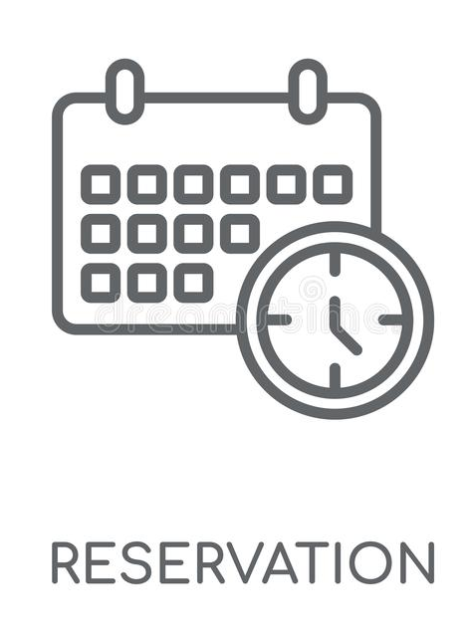
Activities
HackIT
Project division
Project plan
User stories
Notes:
During the HackIT week we spend our time visualizing the current system, at the end we came up with a problem and a solution for that problem.
After this week, the group leaders have divided the project in consultation with Carli among the groups.
We ended up with the reservation system part.
We worked on the project plan, including possible research questions.
Lastly, we managed to create some user stories

